Slide 1
AI-Based Solar Power Performance and Degradation Intelligence
Python Data Analysis Project — EDA Sprint 1
Industry Renewable Energy — Solar PV Power Generation
Student SIVA KUMAR S (ID: AF05320553)
Course AIML | Batch: ANP-D7444M

Slide 2



Industry Overview
Renewable Energy — Solar Photovoltaic (PV) Power Generation
The data
Why it matters
What comes next
PV time-series data: electrical, irradiance, weather and meter readings.
Shows how power is generated, how good the data is, and how inverters differ.
This EDA is the base for performance, anomaly and degradation work.

Slide 3



Problem Statement
The data
The challenge
Inverters, meters, irradiance and weather sensors record readings over time.
Understand how solar plants generate power — and spot unusual differences between inverters.
The focus
Data quality, irradiance vs power, time patterns and inverter differences.
The limit
EDA only flags what to check next. It does not confirm faults or degradation.

Slide 4
Project Objectives
1
Check data quality: completeness, duplicates and timestamps
5
2
Understand how solar power changes over time
3
Link irradiance and weather to total power
goals for this EDA
4
Compare each inverter under high irradiance
5
Flag items to investigate and prepare for future ML

Slide 5
Our Approach & Key Questions
Q1
Q2
How we did it
Is the data complete and consistent?
How does irradiance relate to power?
Clean, transform, analyze and visualize PV time-series data.
Q3
Q4
How does power vary by hour, day and month?
How do inverters compare under high irradiance?
Python
Pandas
Q5
Q6
NumPy
Matplotlib
Which inverters need a closer look?
How does power relate to weather variables?

Slide 6
Dataset Information
3,461
36
15 min
24
rows
columns (35 original)
sampling interval
inverter power columns
Dataset
NREL PVDAQ — Photovoltaic Data Acquisition Public Datasets
Provider
National Renewable Energy Laboratory (NREL)
System
PVDAQ system 2107
Key features
Inverter AC power, POA irradiance, temperature, wind speed and direction, meter output

Slide 7



Data Collection & Understanding
1 Feb 2024 → 8 Mar 2024
NREL PVDAQ system 2107 · 3,461 records · 35 columns · UTC−08:00
No duplicates
Steady timing
Missing values
No duplicate rows or timestamps were found.
All neighbouring timestamps are 15 minutes apart.
Checked by variable and timing, not removed blindly.

Slide 8
Data Cleaning & Transformation
1
Fix the timeline
Converted timestamps to datetime and sorted them in time order.
2
Check the gaps
Added a time-difference field to confirm steady sampling.
3
Fill the metadata
Rebuilt missing date, hour, month and year from the timestamp.
4
Check quality
Looked for duplicates and for negative power, irradiance and meter values.
5
Protect the original
Worked on a separate copy. Missing values were not blindly filled.

Slide 9
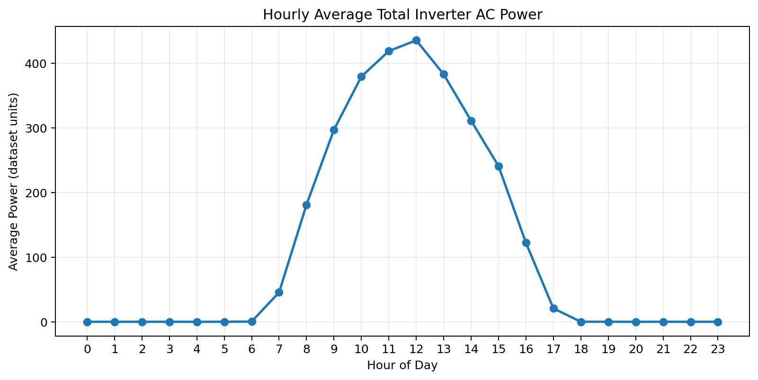
Exploratory Data Analysis
99.92%
53.25%
Data complete, with 0 duplicate rows or timestamps
Zero-power rows (1,843); 46.75% positive (1,618)
r = 0.9933
r = 0.9975
Average power by hour of day
POA vs total power (Spearman 0.9955)
Daily POA vs average power
Irradiance is the strongest recorded link to power.

Slide 10
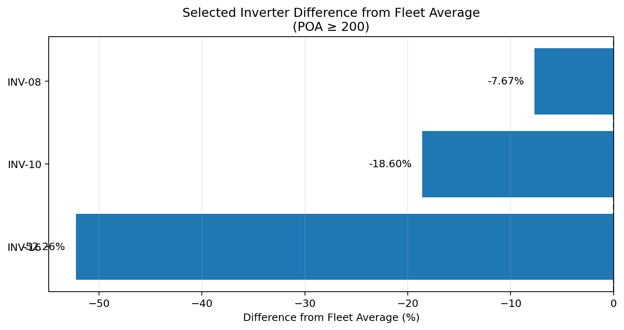
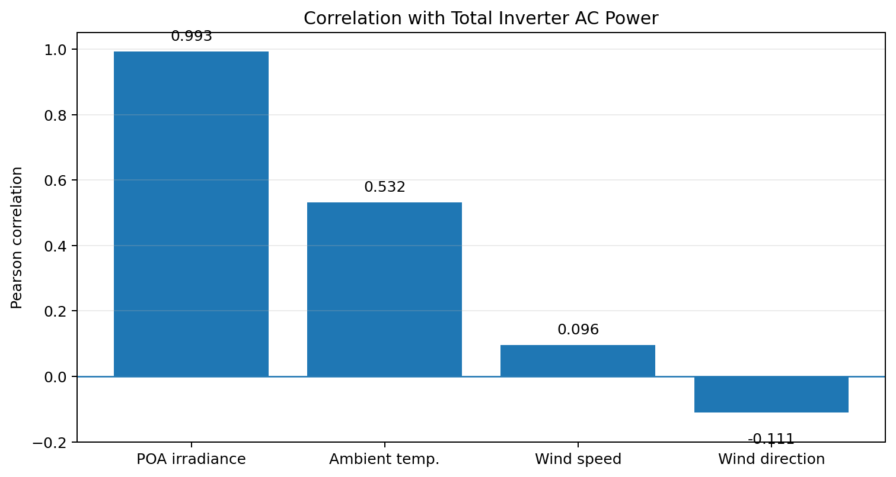
Data Visualization
Inverters vs fleet average
What drives total power?
Selected inverter deviations under POA ≥ 200 highlight below-fleet candidates.
Irradiance shows the strongest recorded linear relationship with total power.

Slide 11
Key Insights & Recommendations
INV-16
INV-10
INV-08
52.26%
18.60%
7.67%
below fleet average
below fleet average
below fleet average
INV-16 also had 263 zero-power readings among 856 high-irradiance rows (30.72%).
Recommendations
Check these inverters using equipment and operating data.
Use longer-term PV data before judging degradation.
Keep comparing inverters under similar irradiance.

Slide 12



Conclusion & Future Scope
A clear baseline for data quality, generation patterns and inverter differences.
Irradiance and total power are strongly linked (Pearson r = 0.9933).
Future scope
Longer-term performance analysis
INV-16, INV-10 and INV-08 need a closer look under high irradiance.
Validated anomaly detection
The period is short, so long-term degradation cannot be confirmed.
Machine-learning development

